Slide 1

www.BrewsFor.me
Project Two

Slide 2
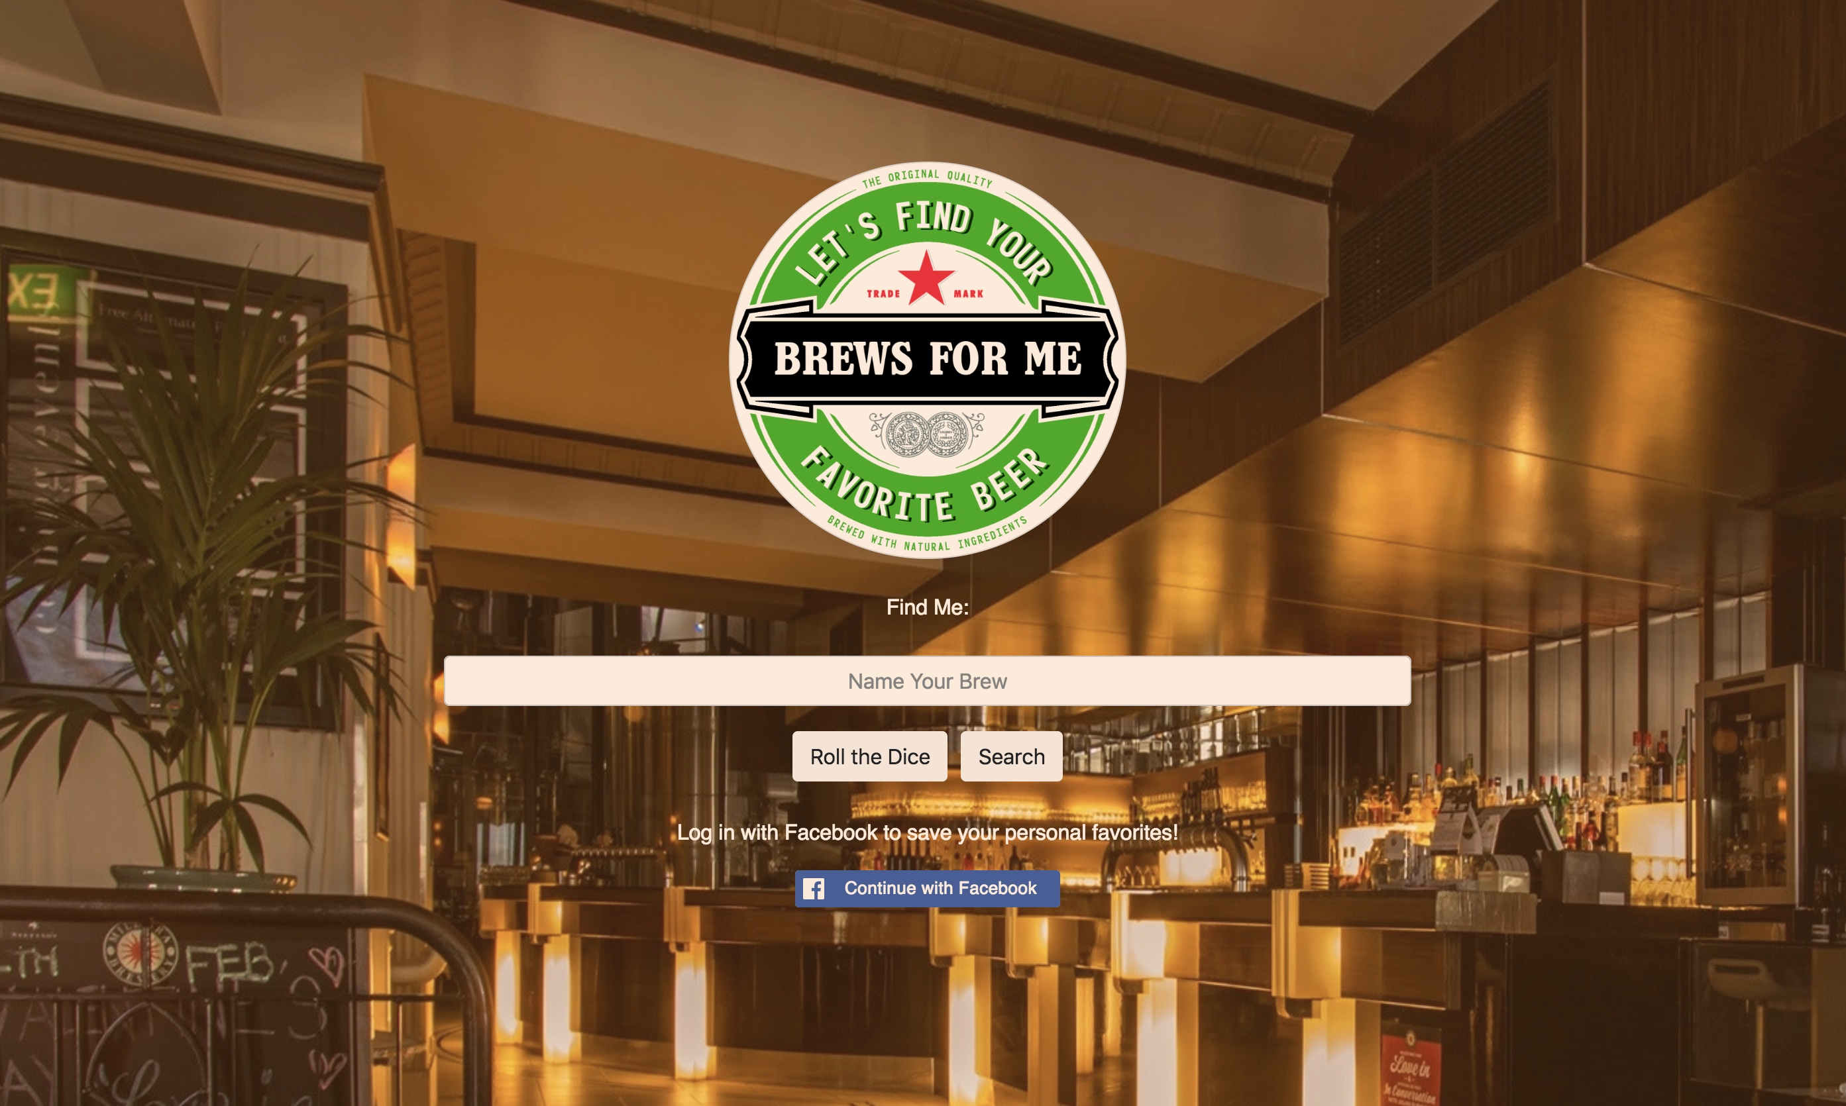
Concept

Slide 3
Provide a fast and easy way for beer lovers to discover new beers that match their unique taste.
Provide multiple search points for users to discover new beers:
A random beer generator & a beer survey
that matches their particular tastes.
Users can login to store their new beer discoveries
for later reference.

Slide 4
Motivation & Inspiration
…well…..BEER!
Creating a way to find new beers users might not
otherwise know about.
Create a personalized experience based off of users
taste & preference.

Slide 5
Design Process
Researching applications and websites that have similar concepts
Comparing different APIs and their potential uses
Creating pure CSS animations that allow users to
interact with generated content matched with personal tastes

Slide 6
Incorporated Technologies
Punk API
Javascript
JQuery
Node.js
MySQL
Heroku
Adobe Creative Suite
Request NPM
Facebook Login(new)
Bootstrap
Handlebars
WebKit
TweenMax.js
CSS (style & animations)

Slide 7
Demo Page
www.BrewsFor.me
https://intense-scrubland-92623.herokuapp.com/

Slide 8
Future Development
Troubleshoot Facebook Login:
flagged as malicious or abusive currently, otherwise working
Incorporate other Beer API’s or databases to expand results
Create more user interaction with features that allow them to
rate beers and share with friends.

